Slide 1
Multiple Regression
Discuss with classmates: Is there ever just one thing that influences a response in a natural system? What are some things that could have influenced our response variable from our last lab on PAR and canopy cover?
Notes:
Ask for two volunteers to share!

Slide 2
What is Multiple Regression?
Multiple regression examines how several predictors (independent variables) together influence a response (dependent variable)
Why use it? Ecological systems are complex; rarely does one factor explain patterns alone!
We want to construct a model that effectively explains observed variation in the response variable!
Example: Species richness may depend on productivity, habitat heterogeneity, and disturbance frequency simultaneously.
Notes:
One thing probably isn’t enough to explain the species richness in an area!
Can also use this if you’re thinking about confounding variables. If you don’t account for some sort of variable, might there be some sort of issue with your analysis? Let’s see a simple example ->

Slide 3

Imagine:
You’re a researcher testing the effects of pesticide application on a pest species. You’re looking into whether the application of a pesticide reduces the number of caterpillars on crops.
You also need to account for bird density. Birds are unaffected by the pesticide, but could be a confounding variable when it comes to the amount of caterpillars around.
Notes:
Imagine if you sprayed the pesticide and the caterpillars were very low numbers and you were like great! Also don’t know why all these birds are flying around!

Slide 4
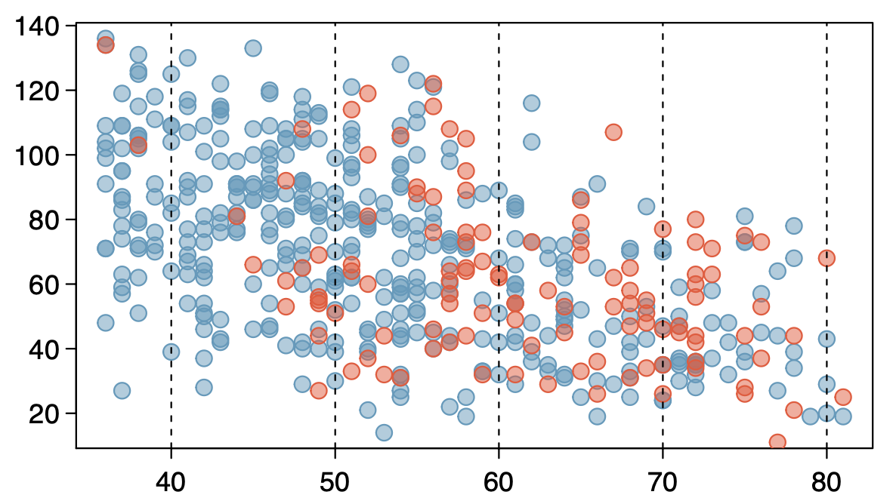
Number of caterpillars per 10m² of crops
Bird density (# individuals per 100 m² of farmland area)
Notes:
Let’s pretend we just measured it this way by randomly sampling quadrats of the plot, and surveying birds across the whole farm area (IDK just roll w it)
The red is where pesticides were applied, and the blue is places where it was not.
You can see in both cases, the number of caterpillars decline with increasing bird density

Slide 5
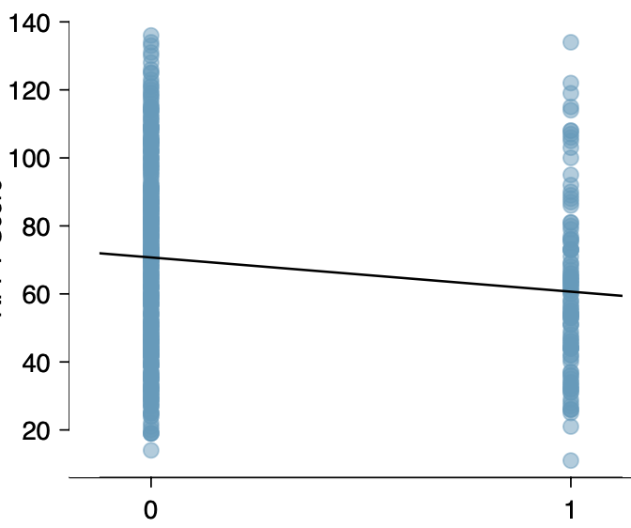
Number of caterpillars per 10m² of crops
no
yes
Pesticide application
Notes:
Without the addition of the bird density variable, this is what we might get.
With multiple regression, we can generate a model that accounts for pesticide application and bird density.

Slide 6
General Equation
Y = β₀ + β₁X₁ + β₂X₂ + … + β_{p}X_{p} + ε
Where:
Y = response variable (e.g., biomass, species richness, number of caterpillars)
X₁, X₂, …, X_{p} = predictor variables (e.g., soil nitrogen, rainfall, canopy cover, pesticide application, bird density)
β₀ = intercept
β₁, β₂, …, β_{p} = regression coefficients (partial effects of each predictor)
ε = error term
Notes:
This should look pretty familiar!
Normally distributed error term ε is assumed to have mean 0 (so just…. Disregard)
In multiple regression, the coefficient βj of a predictor Xj denotes the change in the response variable Y associated with a one unit change in Xj when none of the other predictors change; i.e., each β coefficient in multiple regression plays the role of a slope, as long as the other predictors are not changing
This allows ecologists to separate the effects of correlated environmental drivers

Slide 7
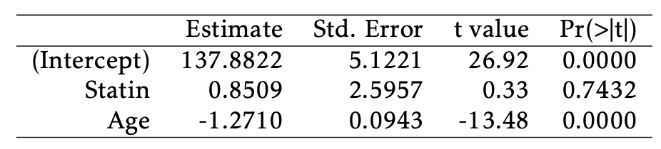
Number of caterpillars =
β₀ + β _{Pesticide}(Pesticide) + β_{Bird Density}(Bird Density).
Pesticide
Bird Density
Estimated # of Caterpillars =
137.8822 + 0.8509(Pesticide) − 1.2710(Bird Density).
Notes:
Here, we are estimating an association between a response variable and primary predictor of interest while adjusting for possible confounders.
ASK: What’s our primary predictor of interest? What’s our possible confounder?
We could also use this to estimate the association between a response variable and several predictors we’re interested in. For instance, maybe farmers are trying a bunch of different things to get rid of pests and we could investigate if the number of caterpillars is associated with pesticide application and the number of times the farmers weed the gardens or something like that.
If we want our regression equation in this case, this is what it would be:

Slide 8
Testing Hypotheses
For this model, the two null hypotheses are H₀: β_{Pesticide} = 0
and H₀: β_{Bird Density} = 0.
Pesticide
Bird Density
The p-values for the tests indicate that at significance level α = 0.05, the association between # caterpillars and pesticide is not statistically significant, but the association between # caterpillars and bird density is significant.
Notes:
Just like simple linear regression, t-statistics can be used to test hypotheses about the slope coefficients!
ASK: Look at our two p-values here and discuss with your classmates: which associations seem to be significant or not?
Then show the answer.
ASK: so would you guys recommend to keep using this pesticide? I’d probably just let the birds do all the work lol

Slide 9
Residual Confounders
Residual confounders can be other variables in a dataset that have not been examined, or variables that were not measured in the study
Exist in almost all observational studies
One of the main reasons that observational studies should be interpreted with caution
A randomized experiment is the best way to eliminate residual confounders
However, randomization may not be possible or ethical
Notes:
Randomization ensures that, at least on average, all predictors are not associated with the randomized intervention, which eliminates one of the conditions for confounding.
Remember that manipulative experiment example about lion fitness and limb loss? Park rangers aren’t going to let you do that!

Slide 10
Assumptions
Linearity – relationships between predictors and the response are linear (when only one predictor variable changes, it is linearly related to the change in the response variable).
Independence – residuals are independent.
Homoscedasticity – residuals have approximately constant variance.
Normality – residuals are approximately normal.
No strong multicollinearity – predictors are not too highly correlated

Slide 11
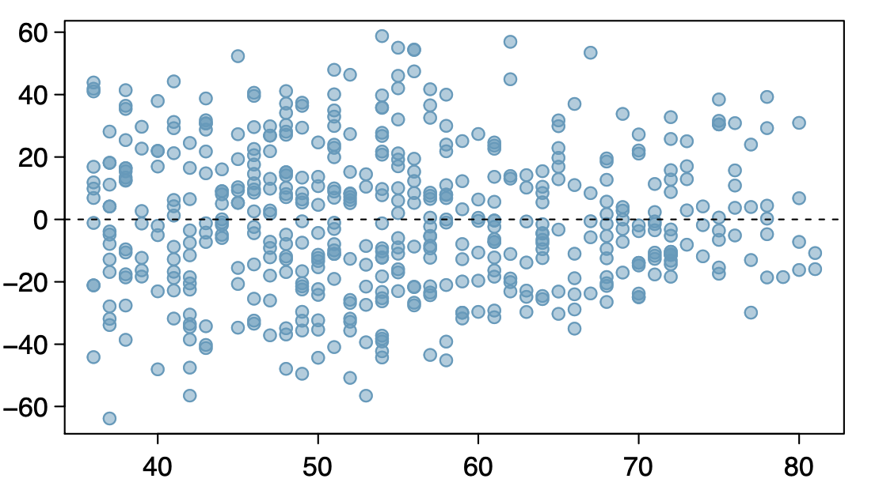
Assumption of Linearity
Examine plots of residuals against each of the predictors
Might show a nonlinear trend that could be corrected with a transformation
Not necessary to assess linearity against a categorical predictor, since a line drawn through two points is necessarily linear
residual
Bird density
imagine this sort of
Notes:
The top graph is looking good and doesn’t show any nonlinear trends!
For the bottom, imagine something like this… not super useful in terms of pesticide applied vs not applied

Slide 12
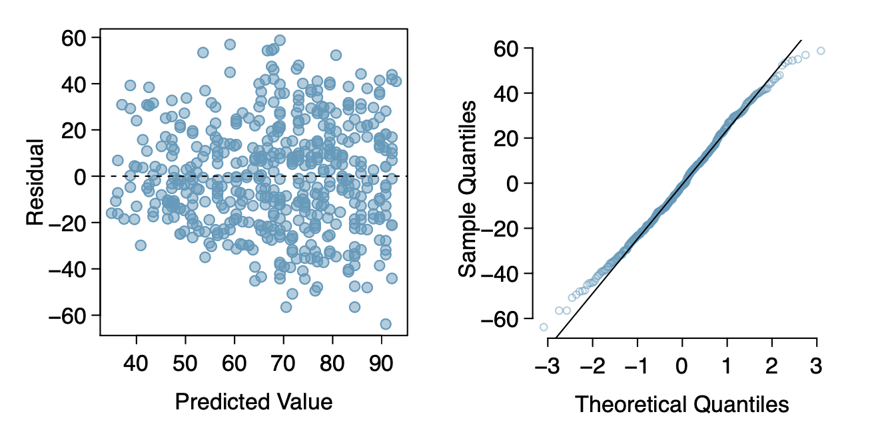
Constant Variance and Normality
Each case has one predicted value and one residual: residuals can still be plotted against predicted values to assess the constant variance assumption
Normal probability plots can be used to check the normality assumption of the residuals
Notes:
Residual vs. predicted plot: regardless of the number of predictors!! Whether you have 1 predictor or 10, you will still have one and one so can make this plot
Both of these plots look good – variance of residuals slightly smaller for lower predicted values, but otherwise pretty constant
QQ plot has some departure in the tails but its good

Slide 13
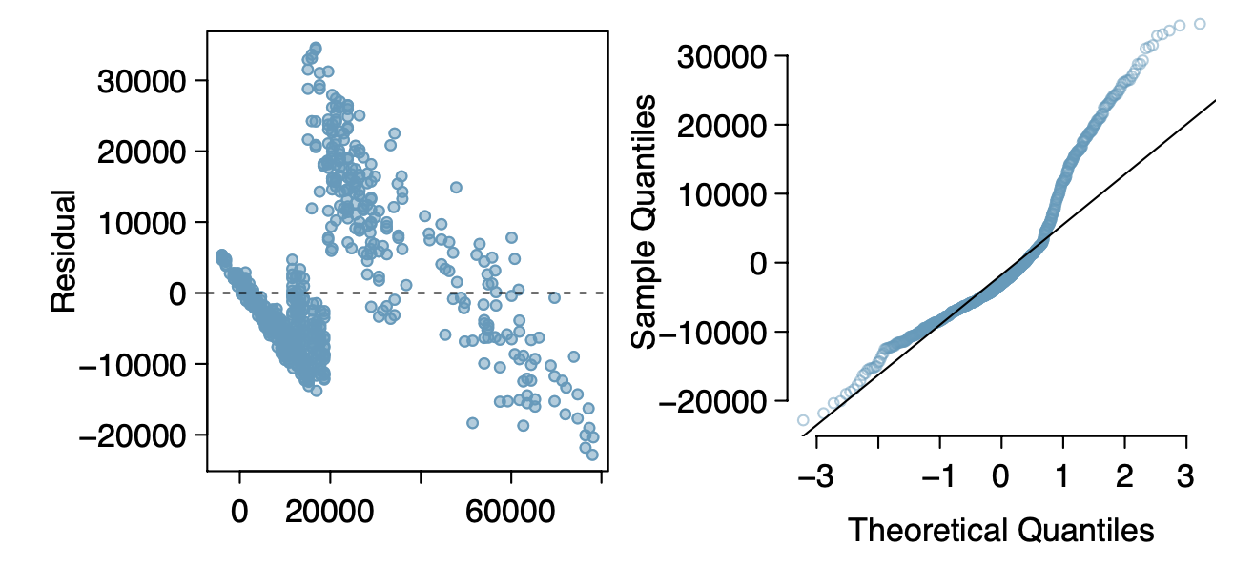
Notes:
Yikes!

Slide 14
Multicollinearity
Exact collinearity occurs if one variable determines the other variable (e.g., X₁ = 100 − 2X₂). Multicollinearity is when this kind of relationship exists between more than two explanatory variables (e.g., X₁ = 100 − 2X₂ + 3X₃)
A strong relationship is enough to have significant multicollinearity
How can we tell?
If the variance inflation factor and tolerance are greater than 5 to 10 and lower than 0.1 to 0.2, respectively (R² = 0.8 to 0.9), multicollinearity exists.
Determines presence of multicollinearity
Cannot detect the explanatory variables causing it
Example: If you check and you have a tolerance/VIF of 0.1/7.5 on an explanatory variable, your model results might not be the most reliable.
Notes:
You can perform a test for these and get numbers for them
More info here: https://pmc.ncbi.nlm.nih.gov/articles/PMC6900425/

Slide 15
R²
Recall: the square of the correlation coefficient r between a response and the single predictor in simple linear regression, and equivalently, it is the proportion of the variation in the response variable explained by the model.
“Square of the correlation coefficient r” – NOT in multiple regression! We have more than one predictor!
Still is the proportion of variance in Y explained by all predictors.
But, adding a variable to a regression model always increases the value of R². What do we do?
Notes:
Sometimes that increase is large and clearly important, such as when birds is added to the model for caterpillar numbers. In other cases, the increase is small, and may not be worth the added complexity of including another variable.

Slide 16
Adjusted R²
Corrects R² for the number of predictors, preventing inflation from overfitting
Balances predictive ability with complexity in a multiple regression model
Does not have an inherent interpretation like R²
  Useful as a statistic for comparing models
  Not the proportion of variation in the response variable explained by the model
Notes:
Essentially, the adjusted R2 imposes a penalty for including additional predictors that do not contribute much towards explaining the observed variation in the response variable.

Slide 17
Example:
Model with the response variable caterpillars and predictor pesticide : R² = 0.0239
Model with the response variable caterpillars and predictors pesticide AND bird density: R² = 0.2852
  explains almost 29% of the variability in RFFT scores
Adjusted R² in the model with both pesticide and birds is 0.2823
  essentially the same as the R² value
  additional predictor birds considerably increases the strength of the model, resulting in only a small penalty to the R² value
Notes:
ASK: Which model would you rather use? The one w both predictors, or just one?

Slide 18
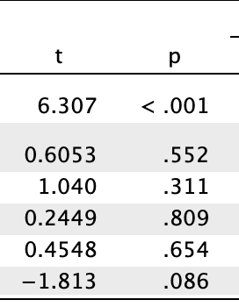
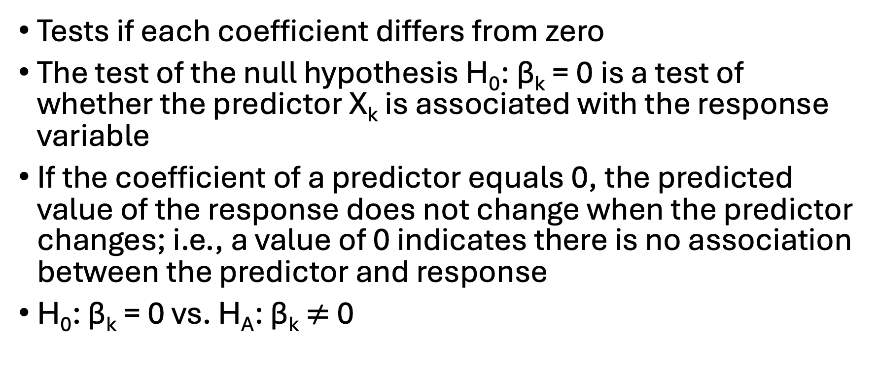
T-tests
Tests if each coefficient differs from zero
The test of the null hypothesis H₀: β_{k} = 0 is a test of whether the predictor X_{k} is associated with the response variable
If the coefficient of a predictor equals 0, the predicted value of the response does not change when the predictor changes; i.e., a value of 0 indicates there is no association between the predictor and response
H₀: β_{k} = 0 vs. H_{A}: β_{k} $≠$ 0

Slide 19
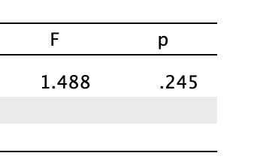
F-test
Tests if predictors, as a group, improve the model compared to a null model
When all the model coefficients are 0, the predictors in the model, considered as a group, are not associated with the response; i.e., the response variable is not associated with any linear combination of the predictors.
H₀: β₁ = β₂ =···= β_{p} = 0 against the alternative that at least one of the coefficients is not 0
A significant p-value for the F-statistic suggests that the predictor variables in the model, when considered as a group, are associated with the response variable
  Mistake: assuming that if the null hypothesis of the F-test is rejected, all coefficients must be non-zero, instead of at least one.

Slide 20
Explanatory Modeling
Goal: construct a model that explains the observed variation in the response variable
No pre-specified primary predictor of interest; explanatory modeling is concerned with identifying predictors associated with the response.
Model selection in the context of a small set of potential predictors
This is a lot of what we do in ecology!

Slide 21
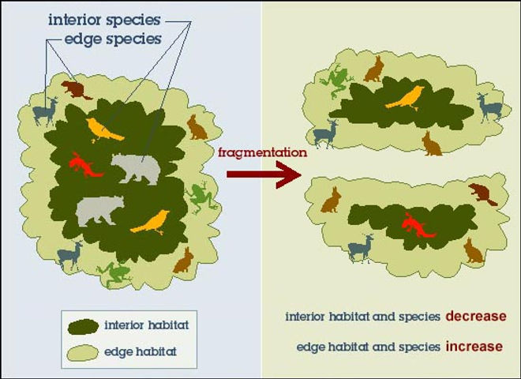
Example: Forest Birds
We are a group of researchers analyzing the effect of habitat fragmentation on bird abundance
Habitat fragmentation: process by which a large contiguous habitat is divided into pieces which are smaller and more isolated
Smaller habitat patches place limits on the populations they can support, and this can reduce genetic diversity / population fitness
Are habitat factors associated with bird abundance?

Slide 22
Example: Variables
abundance: average number of forest birds observed in the patch, as calculated from several independent 20-minute counting sessions.
patch area, measured in hectares. 1 hectare is 10,000 square meters and approximately 2.47 acres.
distance to the nearest patch, measured in kilometers.
distance to the nearest patch larger than the current patch, measured in kilometers.
patch altitude, measured in meters above sea level.
extent of livestock grazing, recorded as either "light", "less than average", "average", "moderately heavy", or "heavy".
year in which the patch became isolated due to habitat fragmentation.
number of years since patch became isolated due to habitat fragmentation
Notes:
We have information on all of these things! Where do we even start???

Slide 23
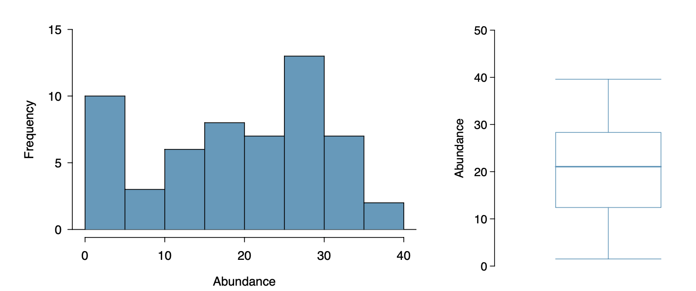
Data Exploration
Notes:
May want to check: the median (21.0) and mean (19.5) are reasonably close, which confirms the distribution is near enough to symmetric to be used in the model without a transformation. The boxplot confirms that the distribution has no outliers.

Slide 24
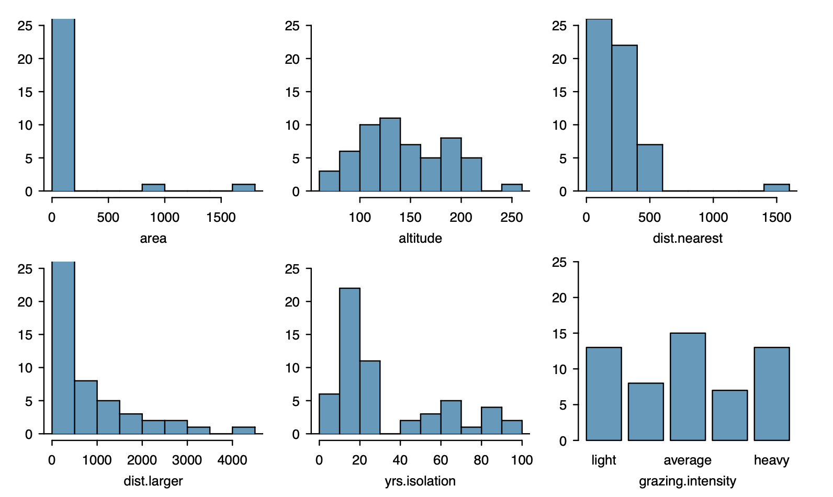
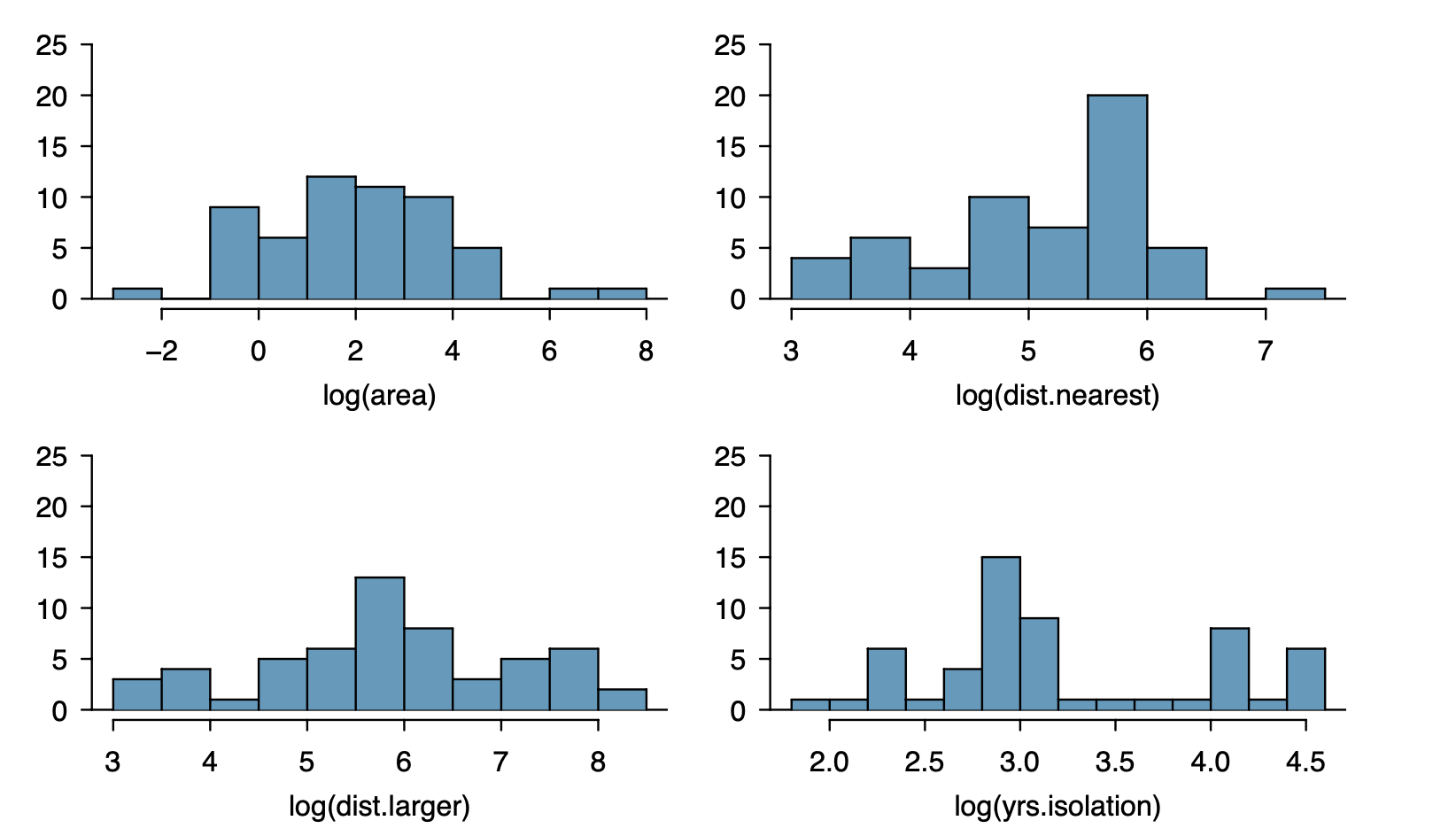
Notes:
The variable altitude is reasonably symmetric, and the predictor grazing.factor
is categorical and so does not take transformations.
natural log transformation of the original variables. All four are more nearly symmetric.

Slide 25
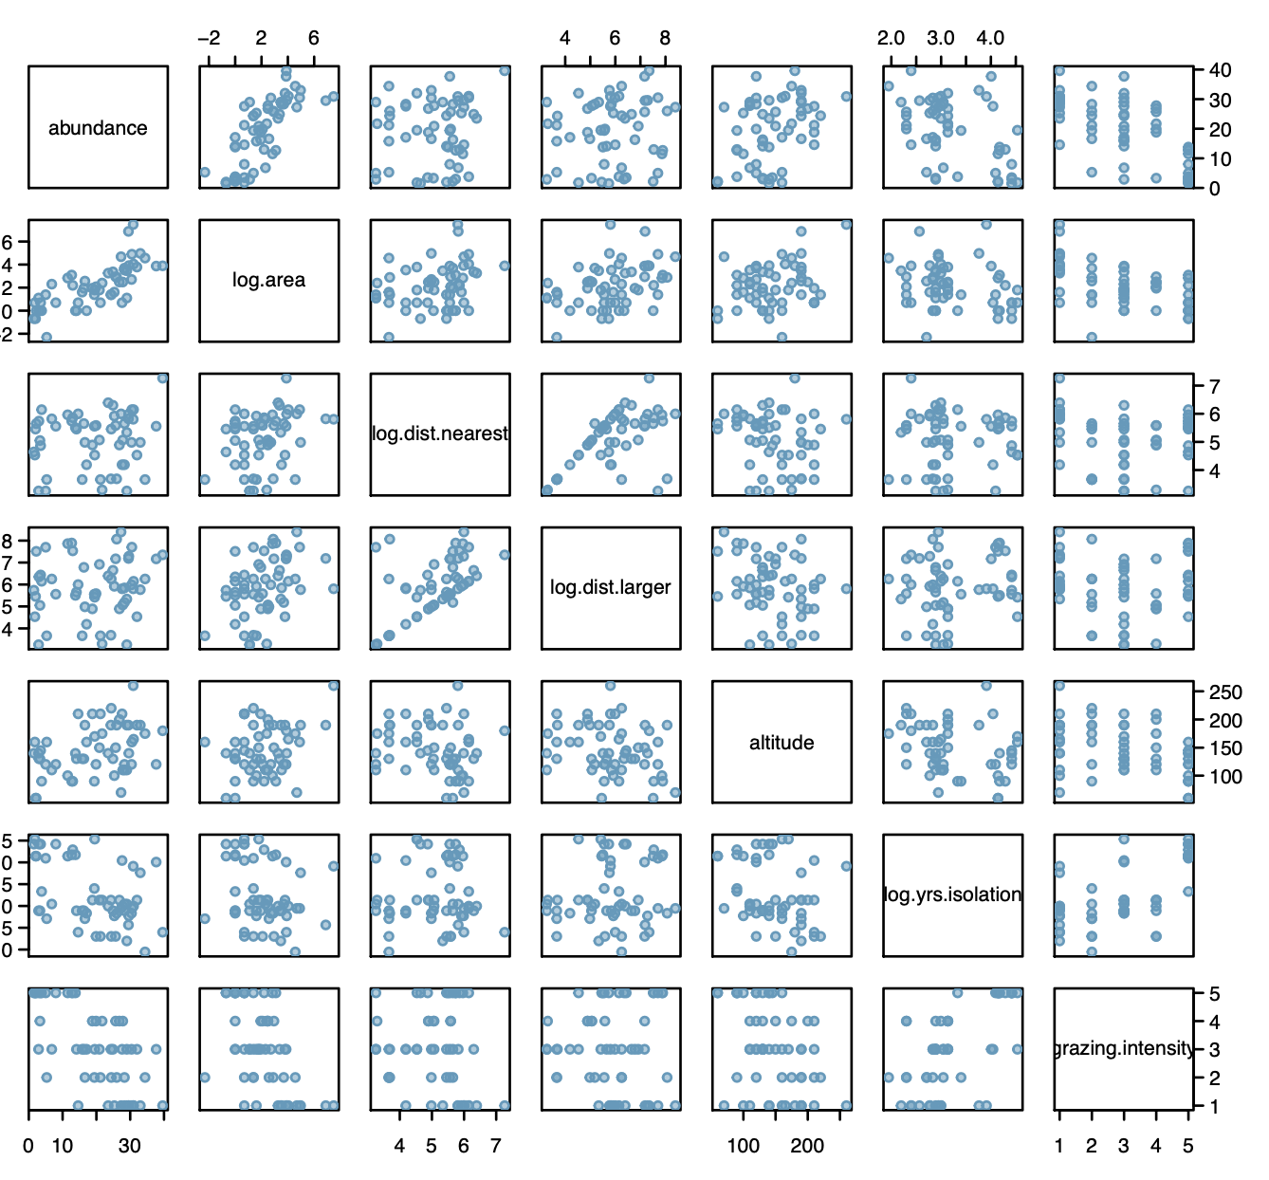
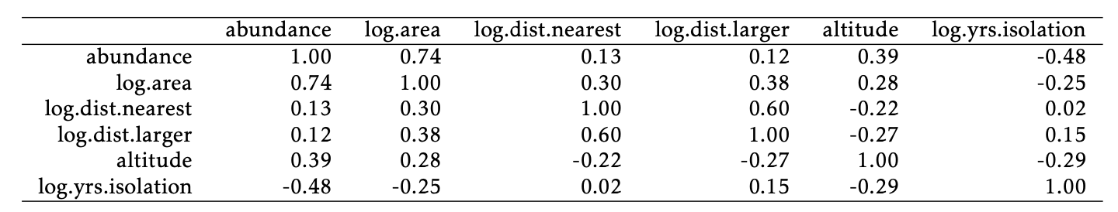
Data Exploration: Choosing your variables
Notes:
A scatterplot matrix can be useful for visualizing the relationships between the predictor and response variables, as well as the relationships between predictors. Each subplot in the matrix is a simple scatterplot; all possible plots are shown, except for the plots of a variable versus itself.

Slide 26
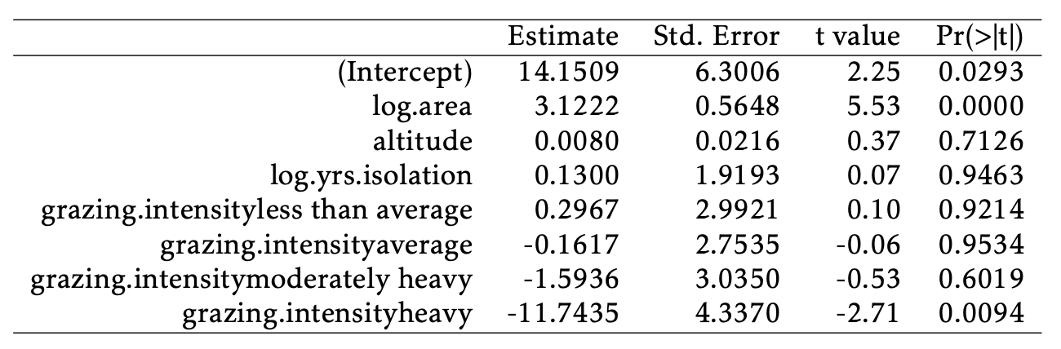
Initial Model
R2 and adjusted R2 for this model are, respectively, 0.728 and 0.688
Notes:
Based on the data exploration, the initial model should include the variables log.area, altitude, log.yrs.isolation, and grazing.intensity;
ASK: what variables here could I knock out?
Two of the variables in the model are not statistically significant at the α = 0.05 level: altitude and log.yrs.isolation. Only one of the categories of grazing.intensity (heavy grazing) is highly significant.

Slide 27
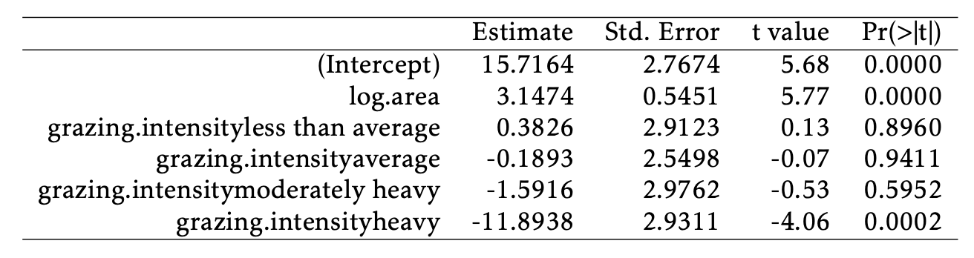
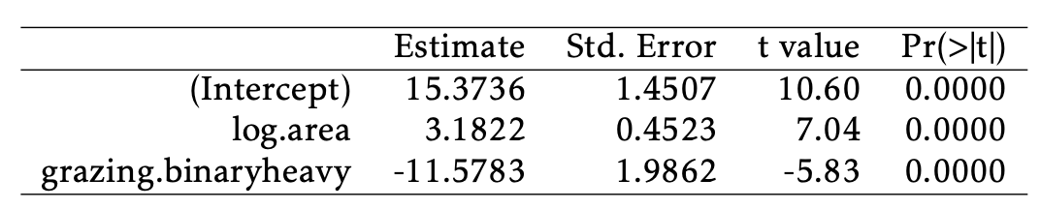
Model Comparison
R² = 0.727, adjusted R² = 0.70
R² = 0.724, adjusted R² = 0.71
Notes:
When either or both of these variables are added, the adjusted R2 decreases from 0.70 to 0.69.
Individual categories of a categorical variable cannot be dropped,
You can leave as-is or collapse into fewer categories
collapse grazing intensity into a two-level variable, with one category corresponding to the original classification of heavy, and another category corresponding to the other four categories; i.e., creating a version of grazing intensity that only has the levels "heavy" and "not heavy". That reminds me of our pesticide vs. non pesticide

Slide 28
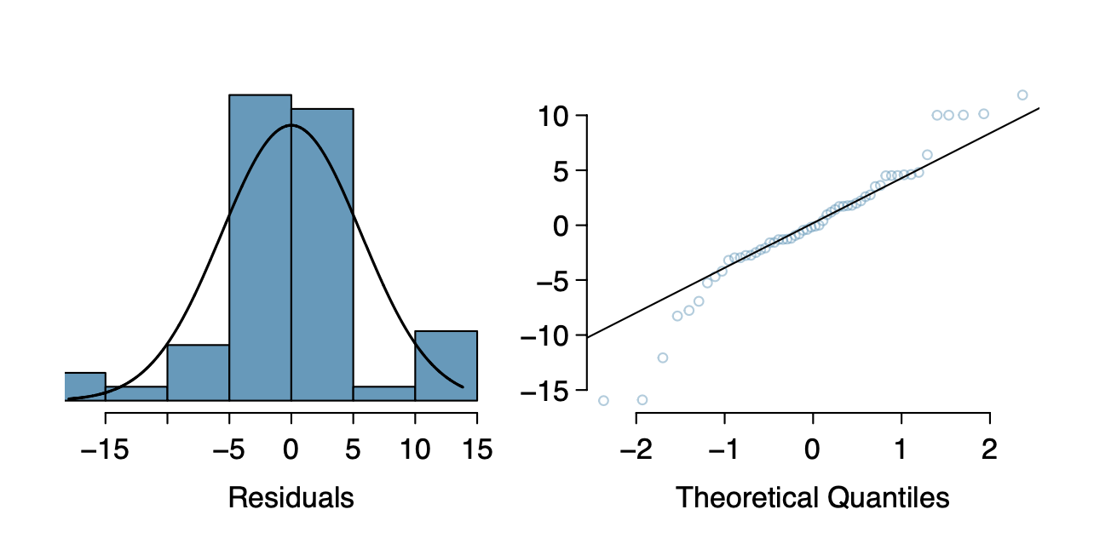
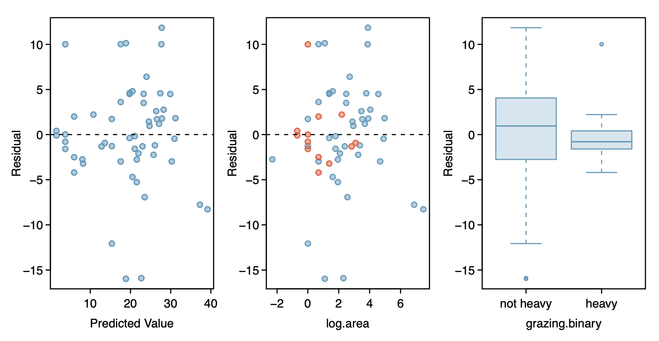
Evaluation
Histogram and normal probability plot of the residuals
Residual values closer to 0 are indicative of a more accurate prediction
Positive values occur when the predicted value from the model is smaller than the observed value
Vice versa for negative values
Notes:
Both show that the residuals follow the shape of a normal density in the middle range (between -10 and 10) but fit less well in the tails.
Both the middle plot and the right plot show that the prediction error is smaller for patches with heavy grazing than for patches where grazing intensity was between "light" and "moderately heavy". Patches with heavy grazing are represented with red points; note how the red points mostly cluster around the y = 0 line,

Slide 29

Forest Birds Conclusion:
R² for the final model (0.72) suggests that patch area and extent of grazing explain a large amount of the observed variability in bird abundance
Residual plots: model may not be particularly accurate
  Some over/under predictions
  Accurate and inaccurate predictions occur at similar ranges of of area
  If it was only inaccurate at a specific range, (i.e., small patches), it would be possible to provide clearer advice about when the model is unreliable.
  Residual plots suggest model is more reliable for patches with heavy grazing
Based on these results, the ecologists might decide to proceed by collecting more data

Slide 30

Why It Matters in Ecology
Ecological responses are rarely driven by a single factor
Multiple regression allows researchers to:
Partition effects among multiple drivers
Control for confounding variables
Test mechanistic hypotheses (e.g., productivity–diversity relationships while accounting for habitat area)

Slide 31
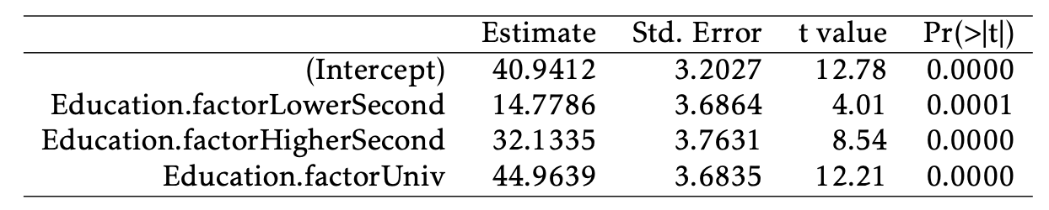
Bonus: what if you applied different classes of pesticide?
Code pesticide class as 0 (no pesticide) 1 (herbal repellent) 2 (weak chemical) 3 (strong chemical)
Each of the predictor levels can be thought of as binary variables that can take on either 0 or 1, where only one level at most can be a 1 and the rest must be 0, with 1 corresponding to the category of interest
RFFT = 40.94 + 14.78(1) + 32.13(0) + 44.96(0) = 55.72.
Notes:
Have one given reference category
Intercept would be no pesticide
The p-values indicate that the change in mean score between participants with only a primary school education and any of the other categories is statistically significant.

